Slide 1

Virtualization and its benefits..
Krishna verma

Slide 2
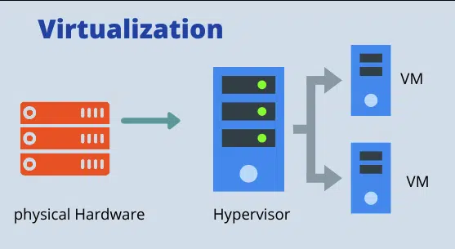
What IS Virtualization?
Virtualization is a technology that allows us to create multiple virtual environments (machines or resources) on a single physical system.
Instead of running one operating system directly on hardware, virtualization uses a hypervisor to run multiple operating systems or applications independently.

Slide 3
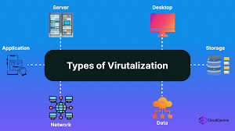
tYpes :-
Server Virtualization – One server becomes many.
Desktop Virtualization – Access desktops remotely.
Storage Virtualization – Combine many storage devices.
Network Virtualization – Create virtual networks.

Slide 4

Benefits :-
Cost Saving – Less hardware needed.
Better Utilization – Efficient use of CPU, RAM.
Scalability – Easy to add or remove VMs.
Disaster Recovery – Quick backup & restore.
Testing & Development – Run multiple OS on one machine.
Energy Efficient – Less power and cooling.

Slide 5

Real-World Examples :-
Amazon Web Services (AWS), Microsoft Azure, and Google Cloud all rely heavily on virtualization to provide cloud services.
VMware and Hyper-V are widely used in enterprises for running multiple servers virtually.
Educational institutions use virtualization to give students access to pre-configured lab environments.

Slide 6

Thank you

